Slide 1
AQUAPONCS: Algorithm to Quantify Properties of Nuclear and Chromatin Structure
CSCI 6118
Kurt Winkler, Emma Aldrich, Henry W, Jiaxin Liu

Slide 2
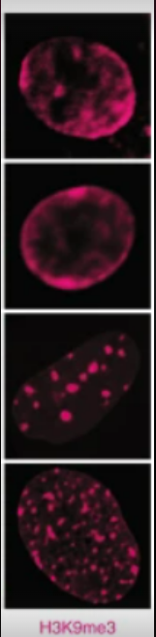
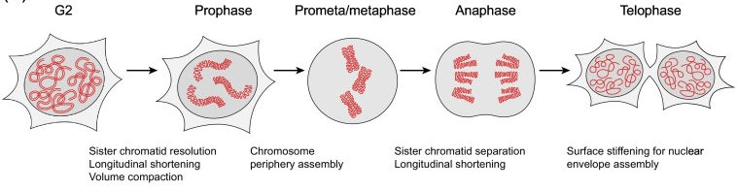
Review of Background: Nucleus structure and chromatin reveal information about the cell
Nucleus structure and chromatin location/density change throughout the cell cycle
Mark and image chromatin → visualize chromatin organization → describe cell stability, gene expression, and cell fate
Example: nuclei of cardiomyocytes with H3K9me3-marked chromatin show reorganization of chromatin in cardiac development/disease

Slide 3
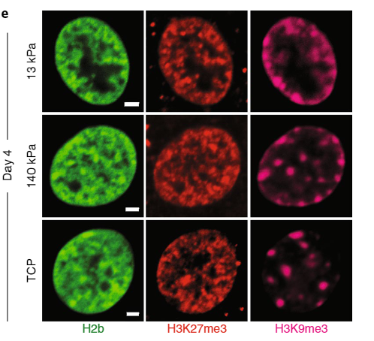
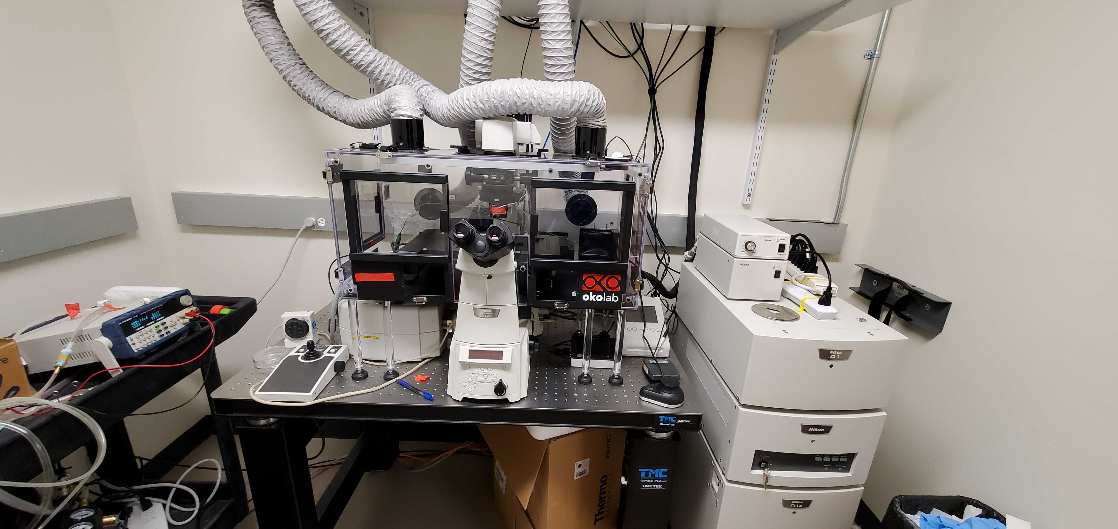
Problem: describing nuclear structure and chromatin is qualitative
Images taken on microscope
Characteristics often described by eye
Less exact nuclear structure

Slide 4
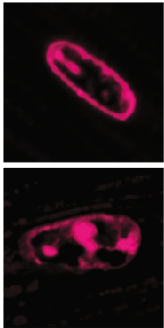
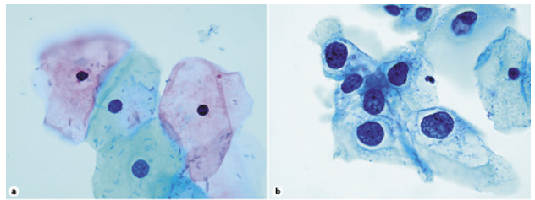
Broader Impact
Cardiovascular Disease
~700,000 US deaths per year
Healthy vs diseased cardiomyocytes
Healthy have chromatin localized to nuclear border
Diseased have chromatin dissociated from border
Due to decreased intranuclear strain in stiff/diseased tissue
Cancer
~600,000 US deaths per year
Malignant vs Normal cells
Nuclear enlargement
Increased nuclear-to-cytoplasmic ratio
Abnormal chromatin distribution
Applications
Advance/automate research
Disease diagnosis/progression
Healthy
Diseased
Normal
Cancer

Slide 5
Objective:
Develop an image processing pipeline to quantify properties of nucleus and chromatin
Visualize and quantify chromatin dispersal and localization
Measure properties of nuclear structure and chromatin blob structure

Slide 6
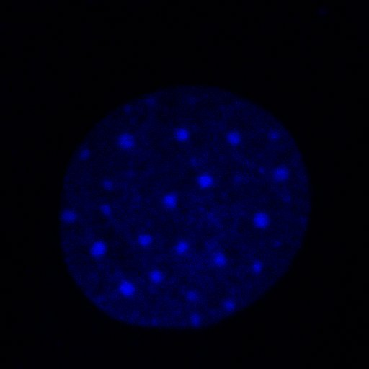
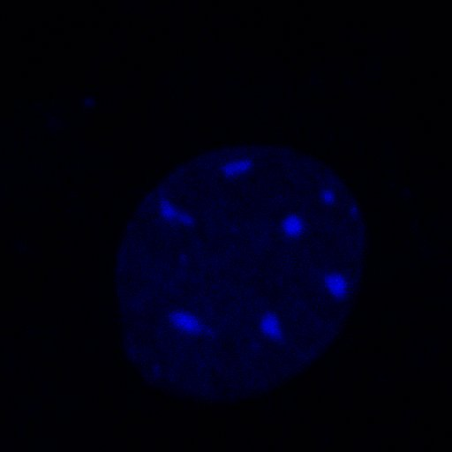
The dataset (example):
Dr. Corey Neu
Mechanical Engineering
Soft Tissue Bioengineering Lab
Mouse stem cells
Stained chromatin blue
Lamin – structural protein in nucleus
Control cells show round chromatin
Lamin-ko cells show elongated/deformed chromatin
Control
Lamin Knock-out

Slide 7
Big Picture Workflow
Nucleus Contour
Blob Contour
Blob Parameters
Blob Detection
Output
Input
Contrast Function
Improve brightness and readability
Identify edge of the nucleus
Identify contours of potential chromatin blobs
Measure blob parameters
Identify "best" blobs
Processed image
&
parameter file
Unprocessed image

Slide 8
Blob Detection Workflow
Input
Output
Create a copy of the image
Identify maxima of pixel intensity
Draw contours around maxima (account for segmentation)
Filter and score the "best" blobs
Processed image and user-friendly parameter file
Processed image

Slide 9
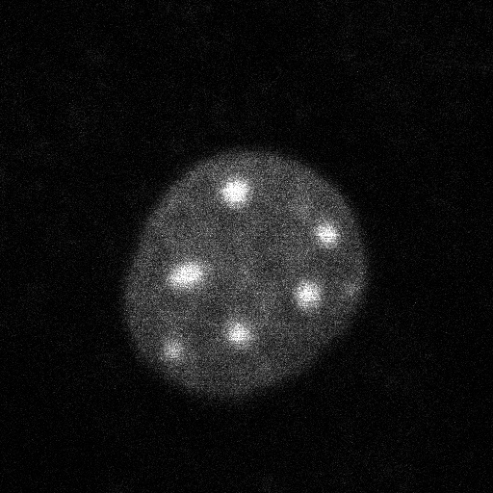
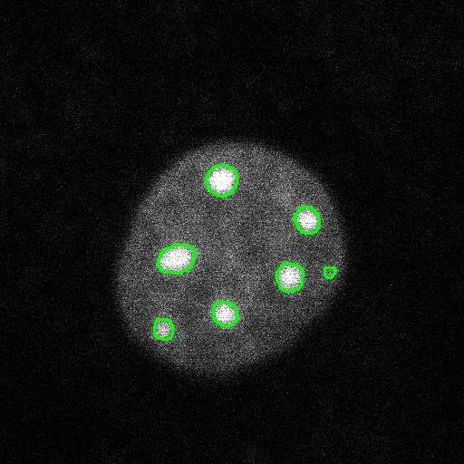
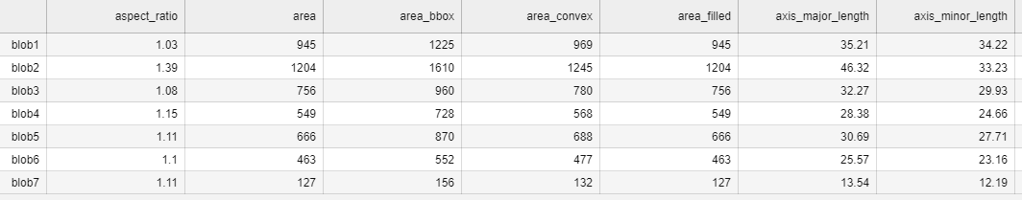
Blob Detection Goal
Input image
Find blobs
Export blob parameters

Slide 10




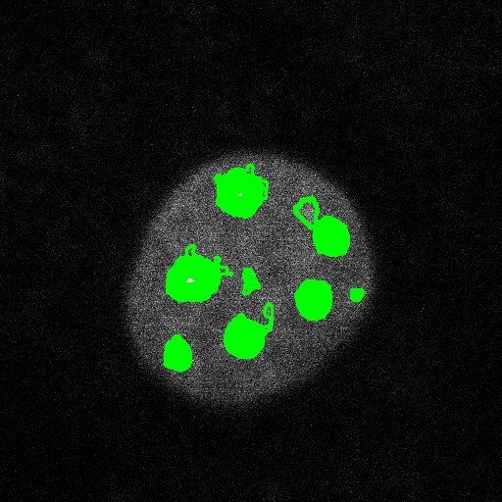

Blob Detection – Behind the Scenes
Input image
50
80
110
140
Thresholds
All contours
Filtered blobs
Final blobs
Filter
Score Blobs
Area
Circularity
Area
Roughness

Slide 11
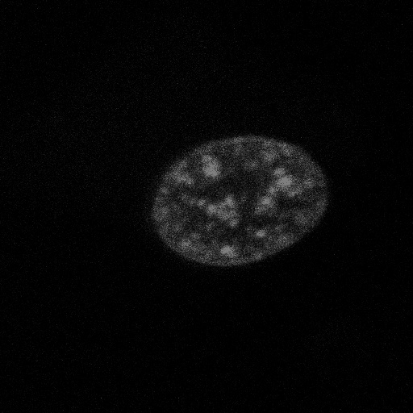


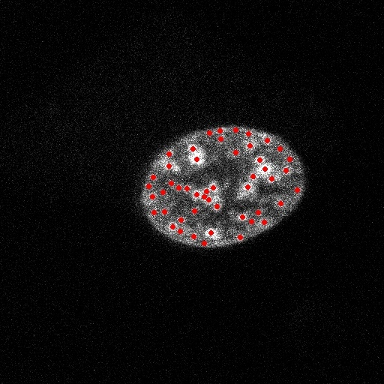
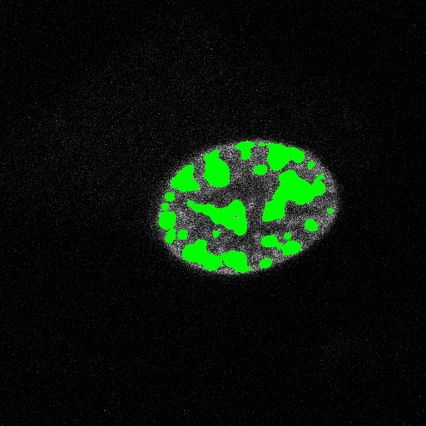



Blob Detection Example (Hard)
Input image
Scaled gray image
Blurred image
Peak local maxima
Maxima blobs
Filtered blobs
Similar blobs
No outlier blobs

Slide 12
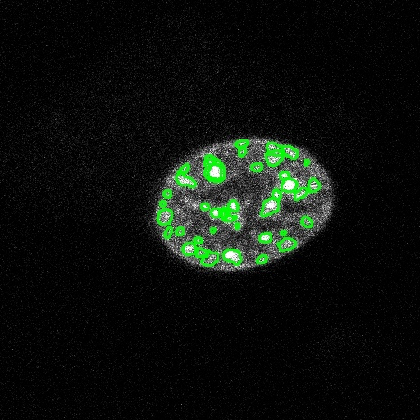

Blob Detection Example (hard)
...
Input image
Best blobs
Final blobs

Slide 13
Key Functions
Contrast function - Rescale pixel intensity by a percentage of the brightest pixels
Contour function – Identify the edge of the nucleus, chromatin blobs
Blob parameters – Measure and store properties of chromatin blobs in a class variable
Aspect ratio, area, axes lengths, centroid, circularity, eccentricity, intensity, perimeter, roughness, solidity...
Blob main – Carry out blob detection workflow
Get params - Summarize parameters from blob param function and build a dictionary for the output file

Slide 14
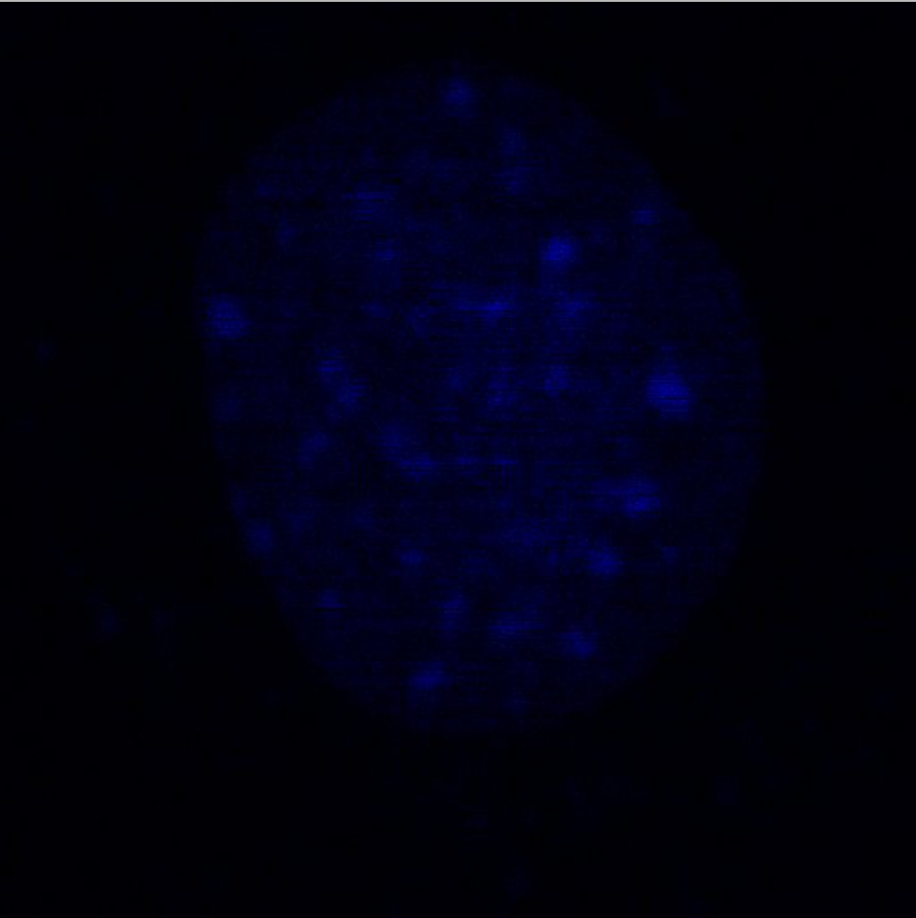
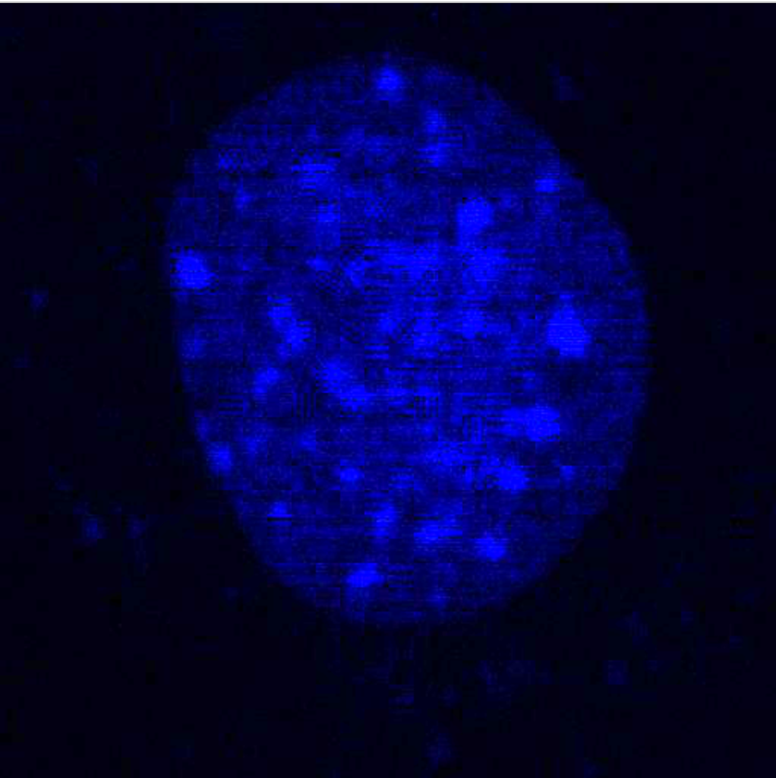
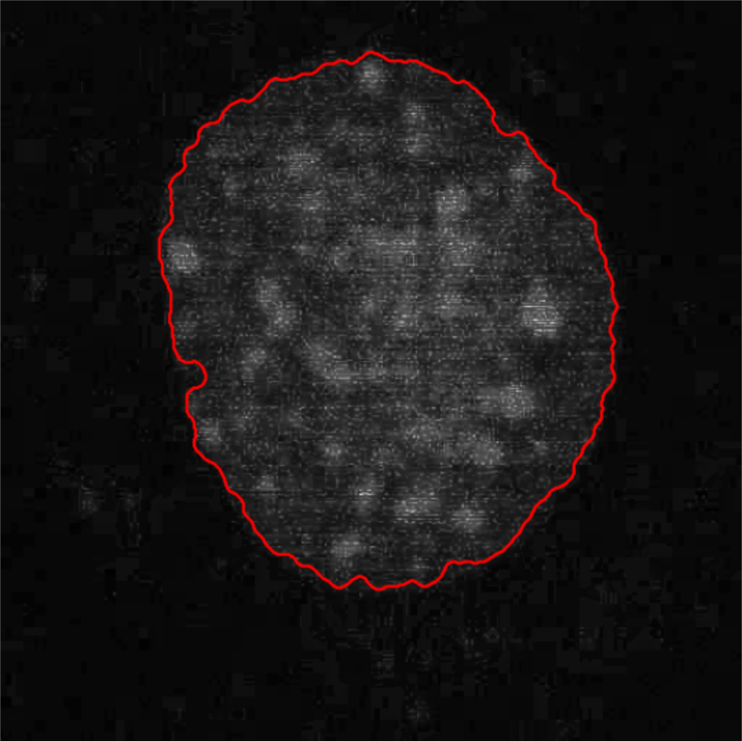
Example
Original Image
Contrasted Image
Contour

Slide 15
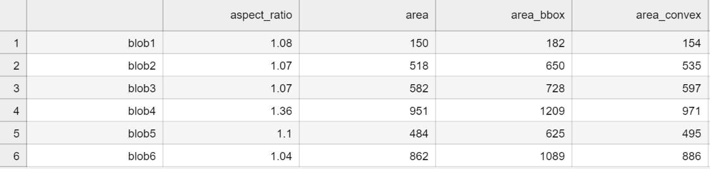
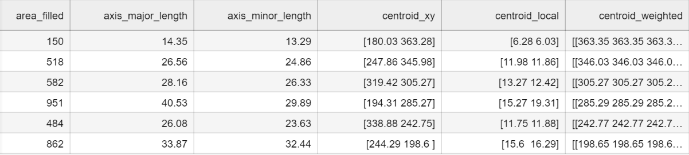
Output
Outputs
Input image

Slide 16


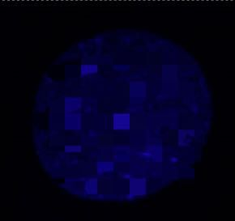
Experimental Challenges
Bad contrast, blurry – resolution issues
Separating noise from blobs – quantifying noise threshold
Defining contours – quantifying contour threshold
Some bad examples

Slide 17
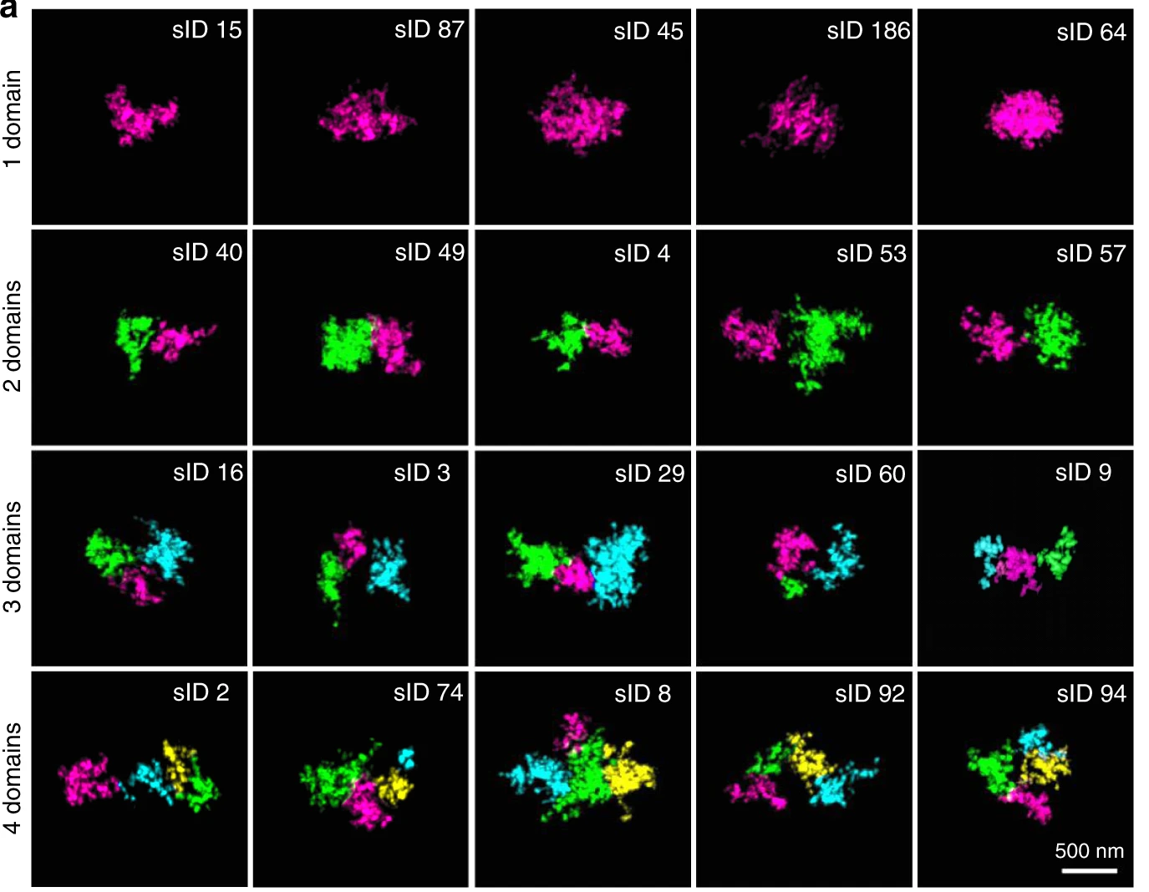
Future Development
Future Development
2D movies
3D image analysis
(Trzaksoma et al. 2020)

Slide 18

Questions?

Slide 19
References
Batty, P., & Gerlich, D. W. (2019). Mitotic Chromosome Mechanics: How Cells Segregate Their Genome. Trends in Cell Biology, 29(9), 717–726. https://doi.org/10.1016/j.tcb.2019.05.007
Fischer, E. G. (2020). Nuclear Morphology and the Biology of Cancer Cells. Acta Cytologica, 64(6), 511–519. https://doi.org/10.1159/000508780
How is chromatin structured? (2017, October 2). Mapping Ignorance. https://mappingignorance.org/2017/10/02/how-is-chromatin-structured/
Phillip, J. M., Wu, P.-H., Gilkes, D. M., Williams, W., McGovern, S., Daya, J., Chen, J., Aifuwa, I., Lee, J. S. H., Fan, R., Walston, J., & Wirtz, D. (2017). Biophysical and biomolecular determination of cellular age in humans. Nature Biomedical Engineering, 1(7), Article 7. https://doi.org/10.1038/s41551-017-0093
Seelbinder, B., Ghosh, S., Schneider, S. E., Scott, A. K., Berman, A. G., Goergen, C. J., Margulies, K. B., Bedi, K. C., Casas, E., Swearingen, A. R., Brumbaugh, J., Calve, S., & Neu, C. P. (2021). Nuclear deformation guides chromatin reorganization in cardiac development and disease. Nature Biomedical Engineering, 5(12), Article 12. https://doi.org/10.1038/s41551-021-00823-9
Trzaskoma, P., Ruszczycki, B., Lee, B., Pels, K. K., Krawczyk, K., Bokota, G., Szczepankiewicz, A. A., Aaron, J., Walczak, A., Śliwińska, M. A., Magalska, A., Kadlof, M., Wolny, A., Parteka, Z., Arabasz, S., Kiss-Arabasz, M., Plewczyński, D., Ruan, Y., & Wilczyński, G. M. (2020). Ultrastructural visualization of 3D chromatin folding using volume electron microscopy and DNA in situ hybridization. Nature Communications, 11(1), Article 1. https://doi.org/10.1038/s41467-020-15987-2

